Slide 1
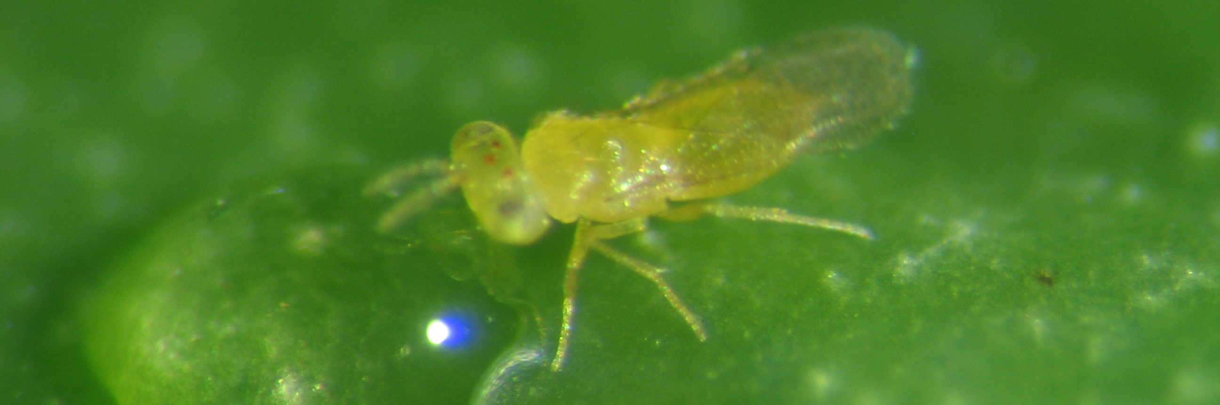
Comparative ecology of sexual and asexual parasitoid wasps
Cyril Matthey-Doret
Supervised by Casper Van Der Kooi
Directed by Tanja Schwander

Slide 2
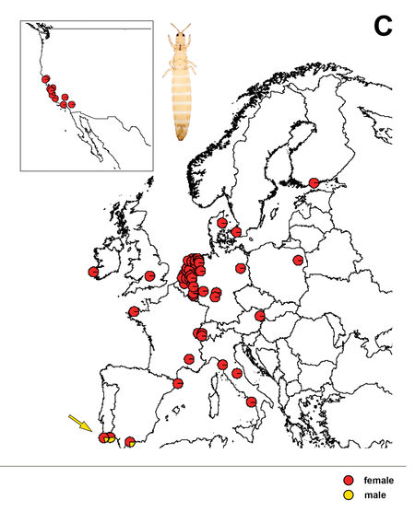
Background
Asexual and sexual species were often found to differ in host range and geographical distribution.
Never tested on a large scale analysis
Aptinothrips rufus
van der Kooi, C. J. and Schwander, T. (2014), EVOLUTION OF ASEXUALITY VIA DIFFERENT MECHANISMS IN GRASS THRIPS (THYSANOPTERA: Aptinothrips). Evolution, 68: 1883–1893. doi:10.1111/evo.12402

Slide 3
The study
Do asexuals and sexuals have different ecologies and distributions ?
Do asexuals have more host species ?
Number of host species
Do asexuals occupy larger regions than sexuals ?
Number of countries/states
Focusing on the Chalcidoidea superfamily

Slide 4
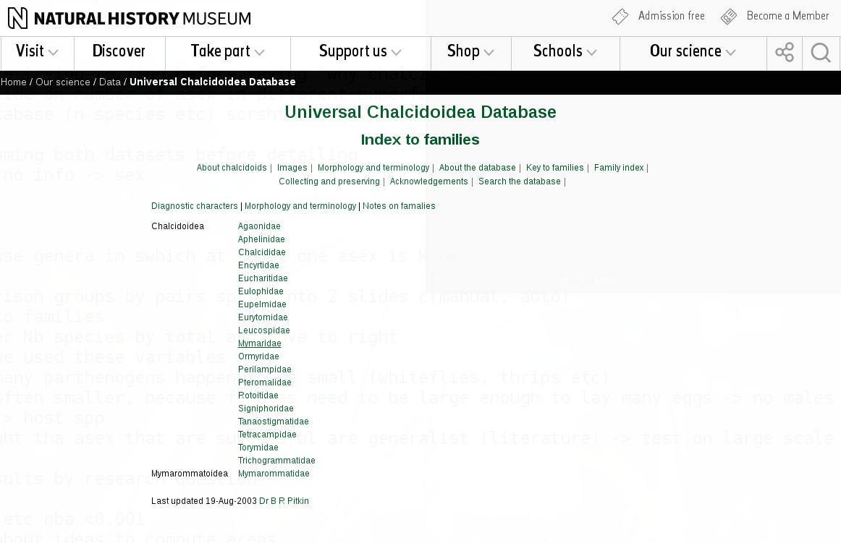
Why Chalcidoidea ?
Many parthenogenetic species
Well studied, many species relevant for biocontrol.
Great database available!
Records for ~31'000 species of Chalcidoidea
host species and distribution

Slide 5


Manual dataset
Gathered by hand in literature
Comparison sex vs asex between the most closely related species
Automated dataset
All data from the same database
Comparing asex vs sex in each genera
Genus
Family
Pair 1
Pair 2
133 species across 32 pairs
50 asexuals, 83 sexuals
8357 species across 66 genera
136 asexuals, 8221 sexuals
asex
sex

Slide 6
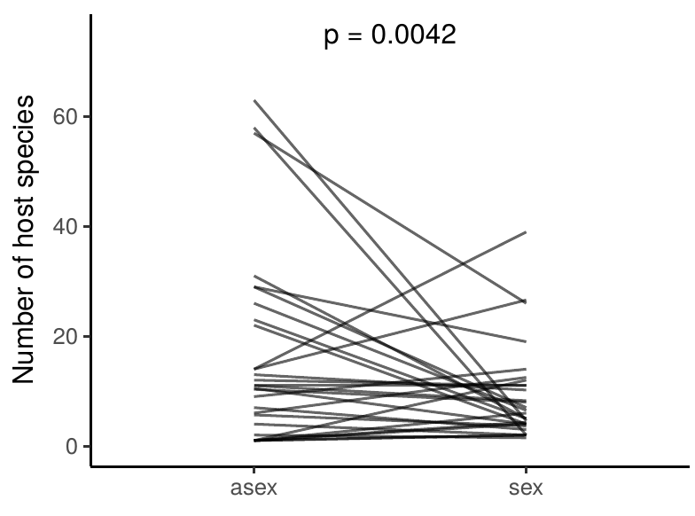
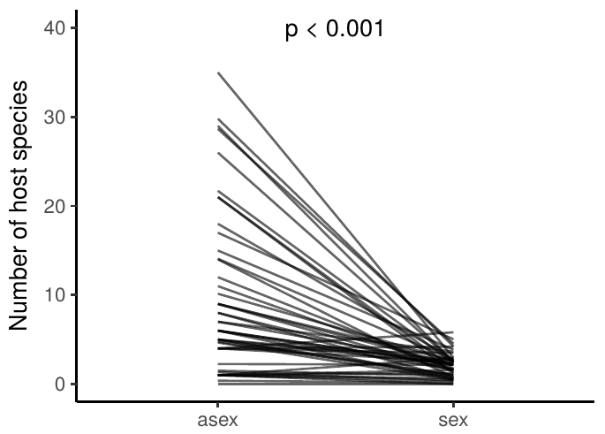
Asexuals have more host species
Manual dataset:
Values per pair
Automated dataset
Values per genus
Generalized linear mixed models:
n.hosts ~ mode + (1| genus / pair)
n.hosts ~ mode + (1| genus)

Slide 7
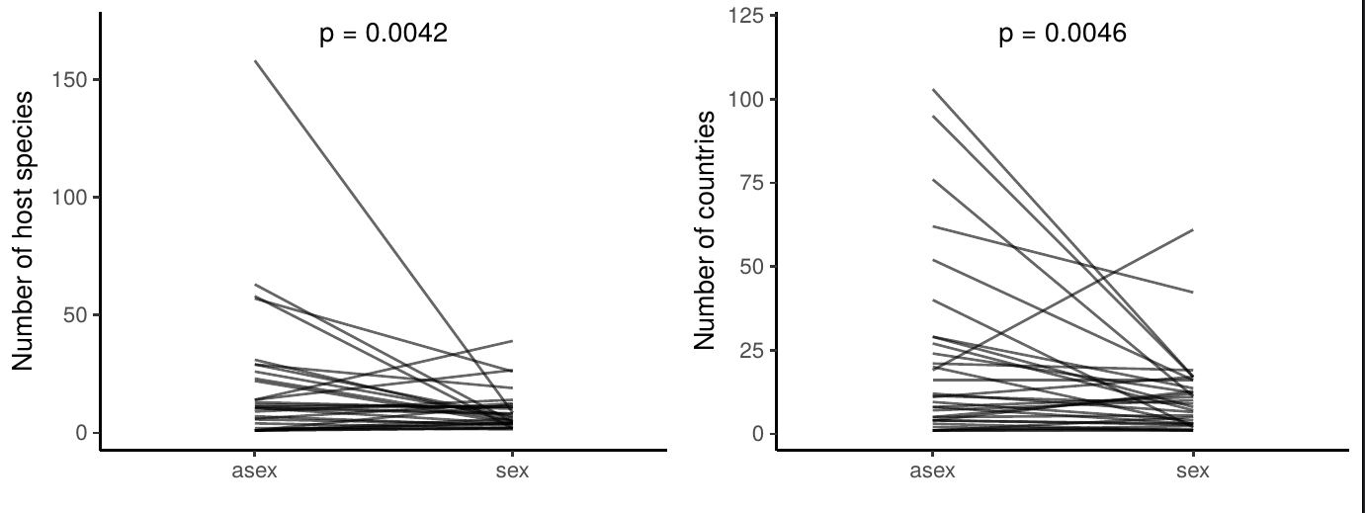
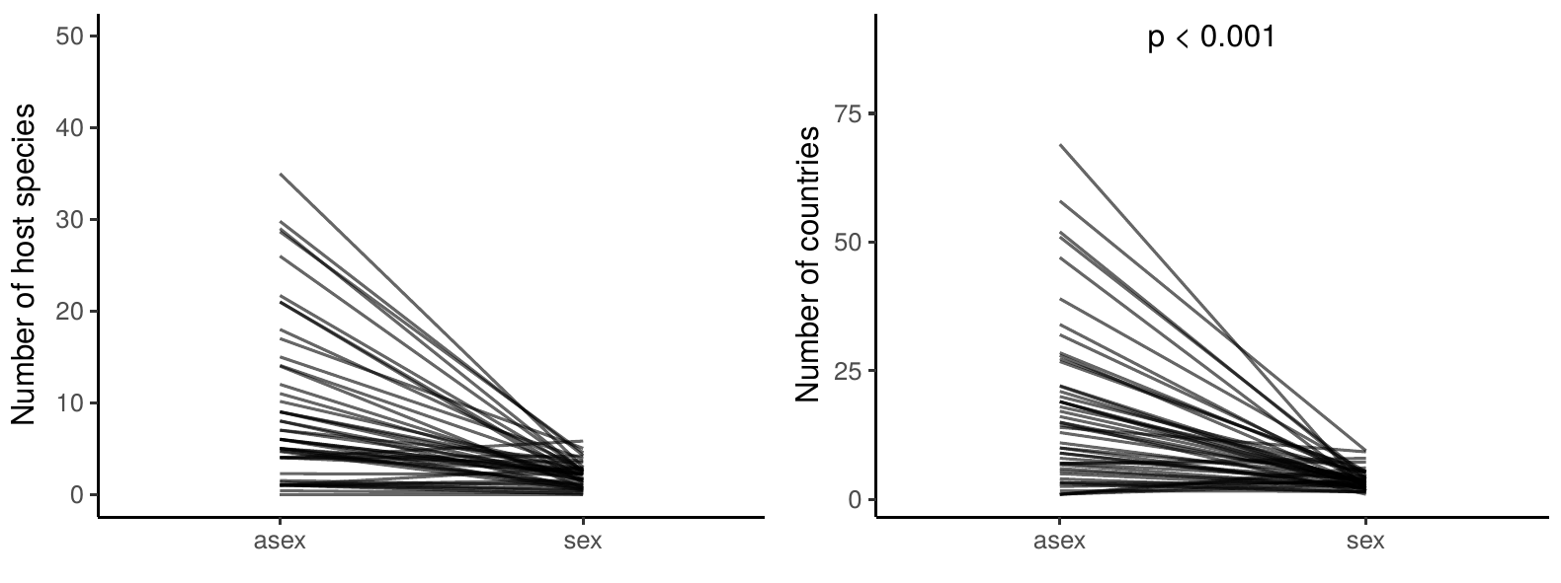
Asexuals are found in more countries
Manual dataset:
Values per pair
Automated dataset
Values per genus
Generalized linear mixed models:
n.countries ~ mode + (1| genus / pair)
n.countries ~ mode + (1| genus)

Slide 8
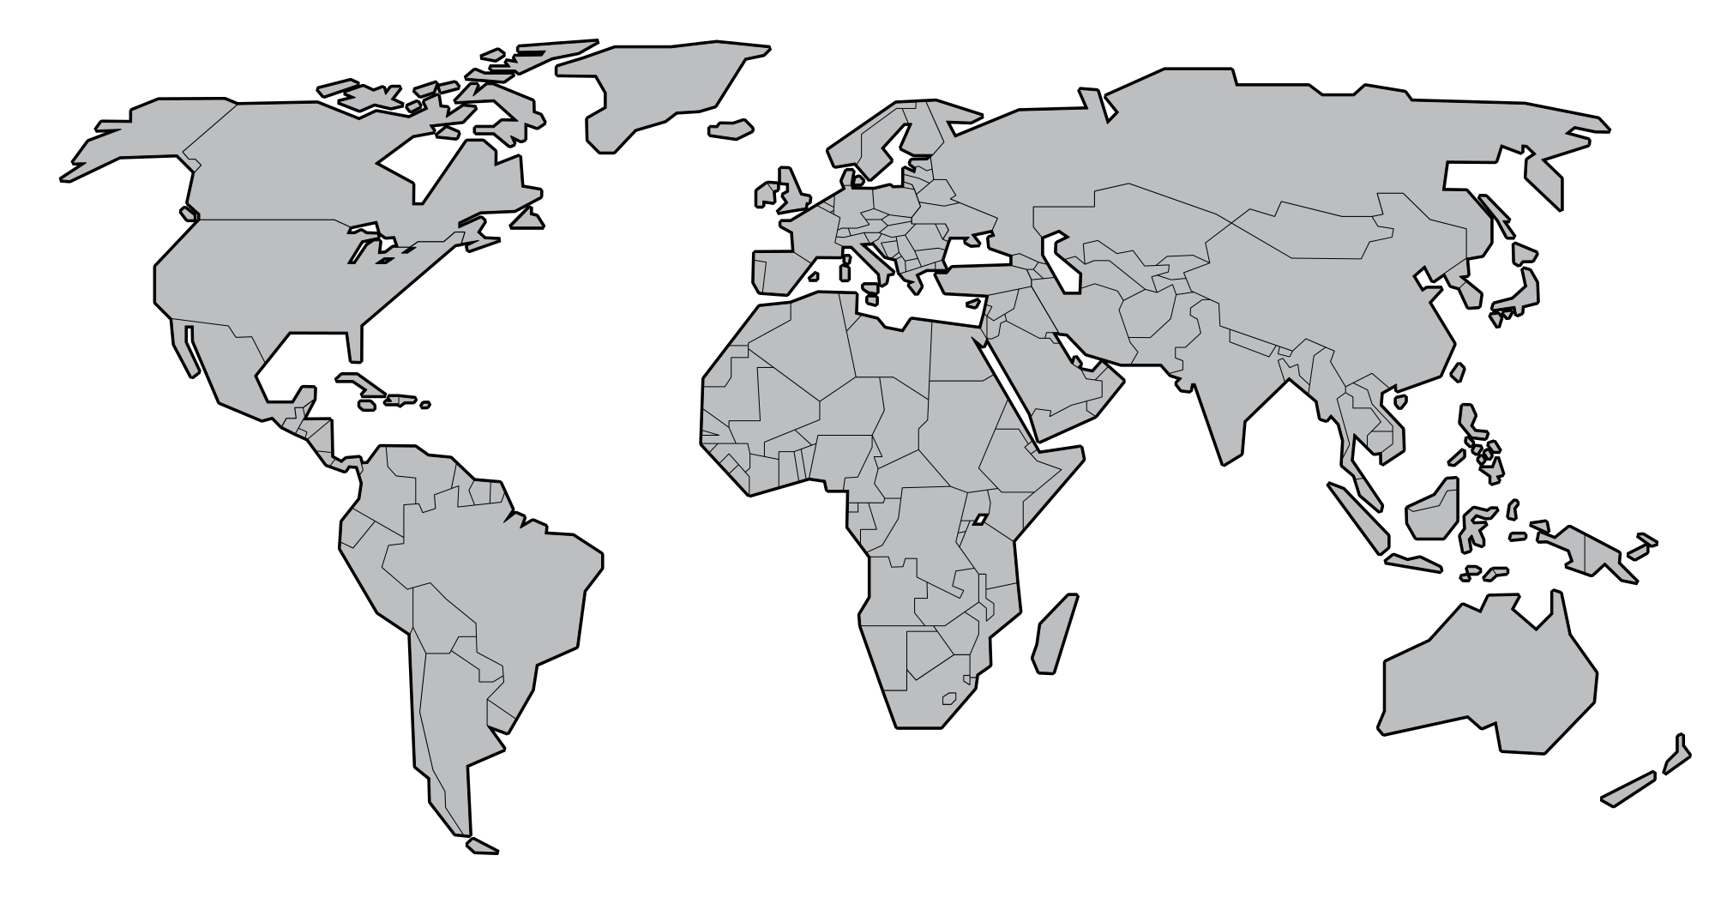
Zooming on distribution
Geographical distribution in more detail using latitude
Max distance from equator.
Min distance from equator

Slide 9
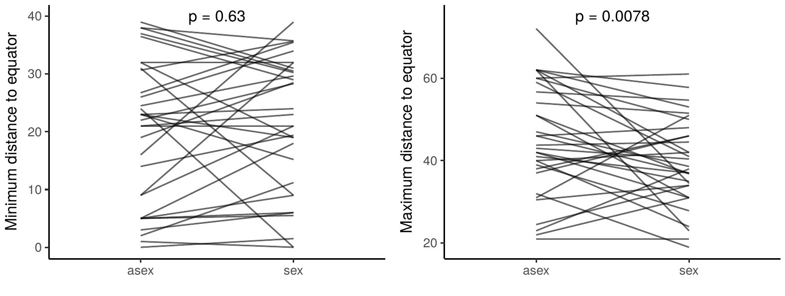
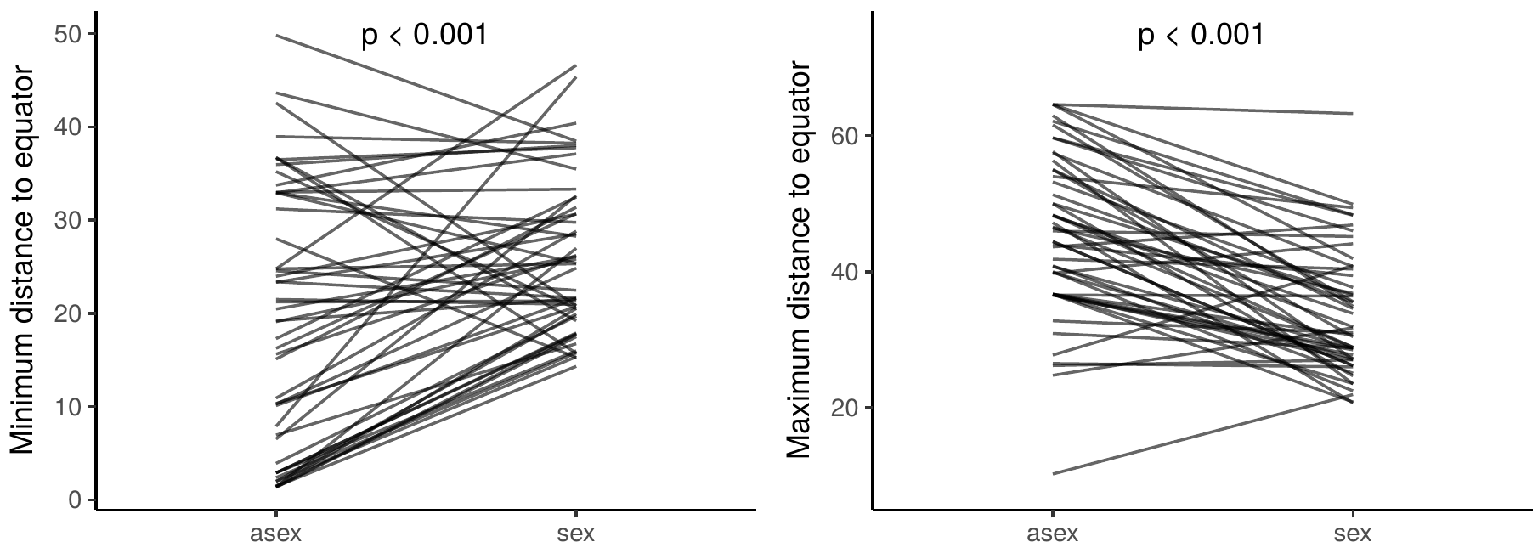
Distribution of asexuals expands towards poles
Manual dataset:
Automated dataset:

Slide 10
Distribution of asexuals expands towards poles
Manual dataset:
Automated dataset:

Slide 11




Does asexuality increases niche width ?
Does the broad niche evolve after transition to asexuality?
Or are sexuals with broad niche more likely to give rise to asexuals?
Sex
Asex
Sex
Asex
Sex
Asex

Slide 12
Does asexuality increases niche width ?
Combining manual and automated datasets
Genus X
Genus X
Sister species
outgroup
vs
Comparing number of host species and countries between sister species and outgroups in each genera

Slide 13
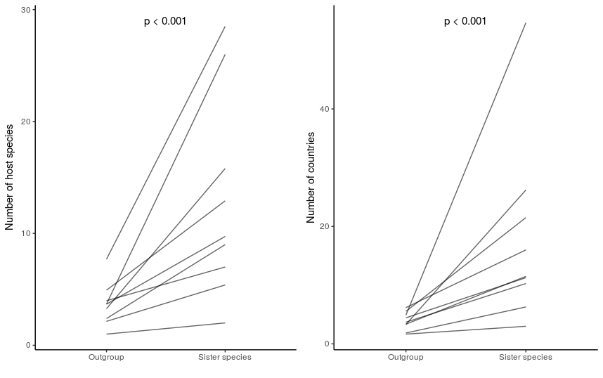
Sexual species from which asexual species diverged already had a large niche
Outgroup
Sister species
Outgroup
Sister species

Slide 14
Conclusions
Asexuals have wider niches:
More host species than sexuals
Found in more countries
Their geographical distributions can expand more towards poles.
Ecological attributes favour the transition of asexual lineages.
Asexual
Sexual

Slide 15
Supplementary slides

Slide 16
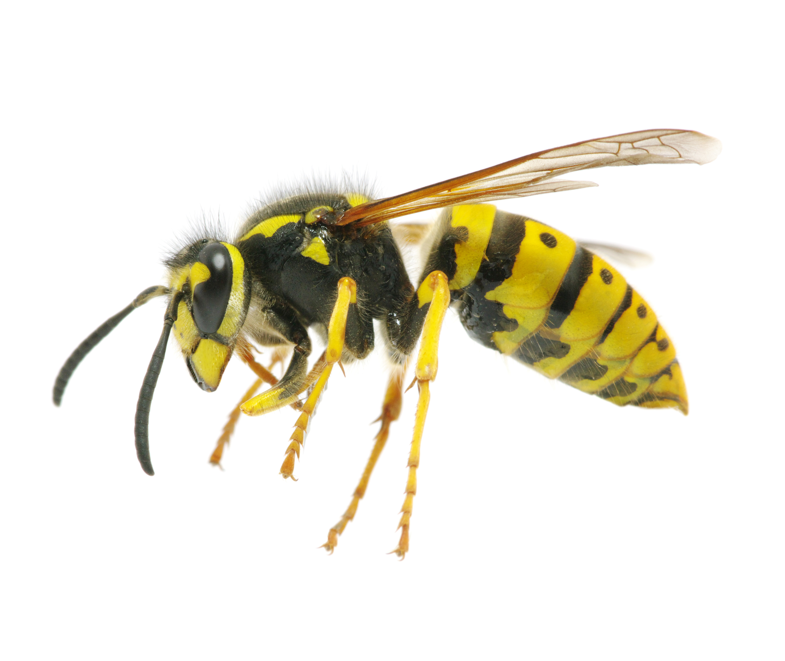
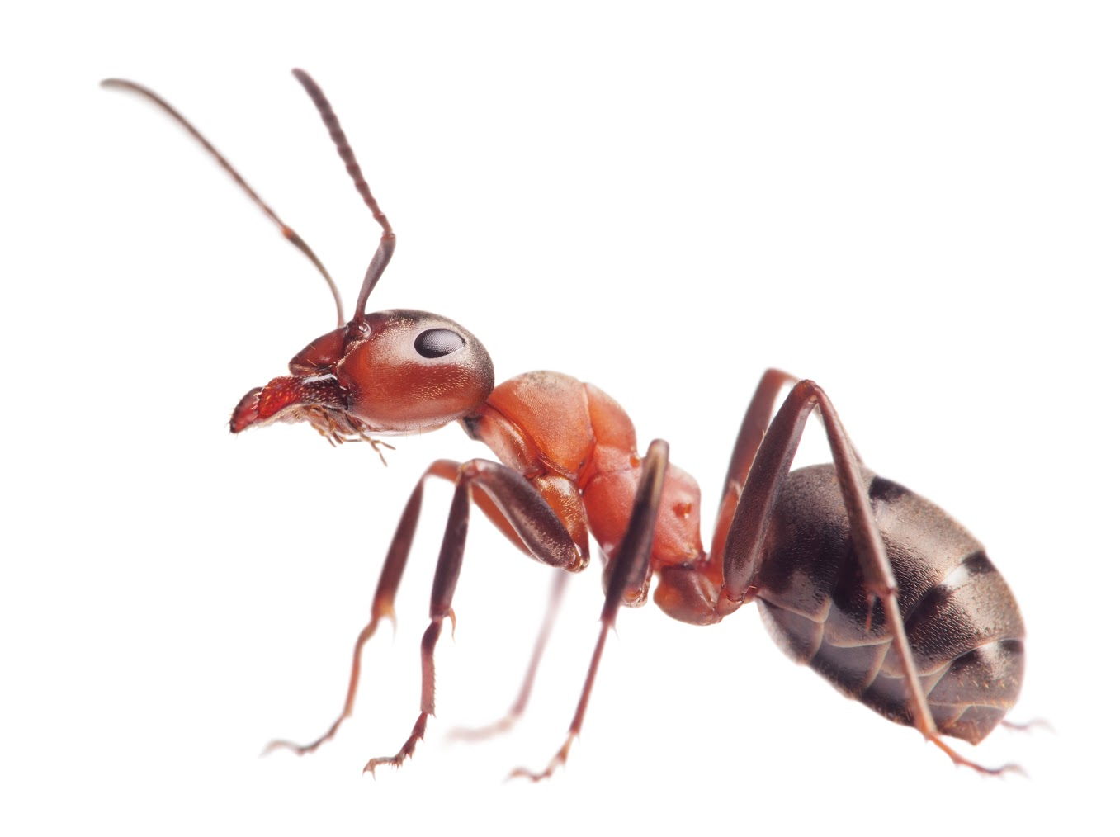

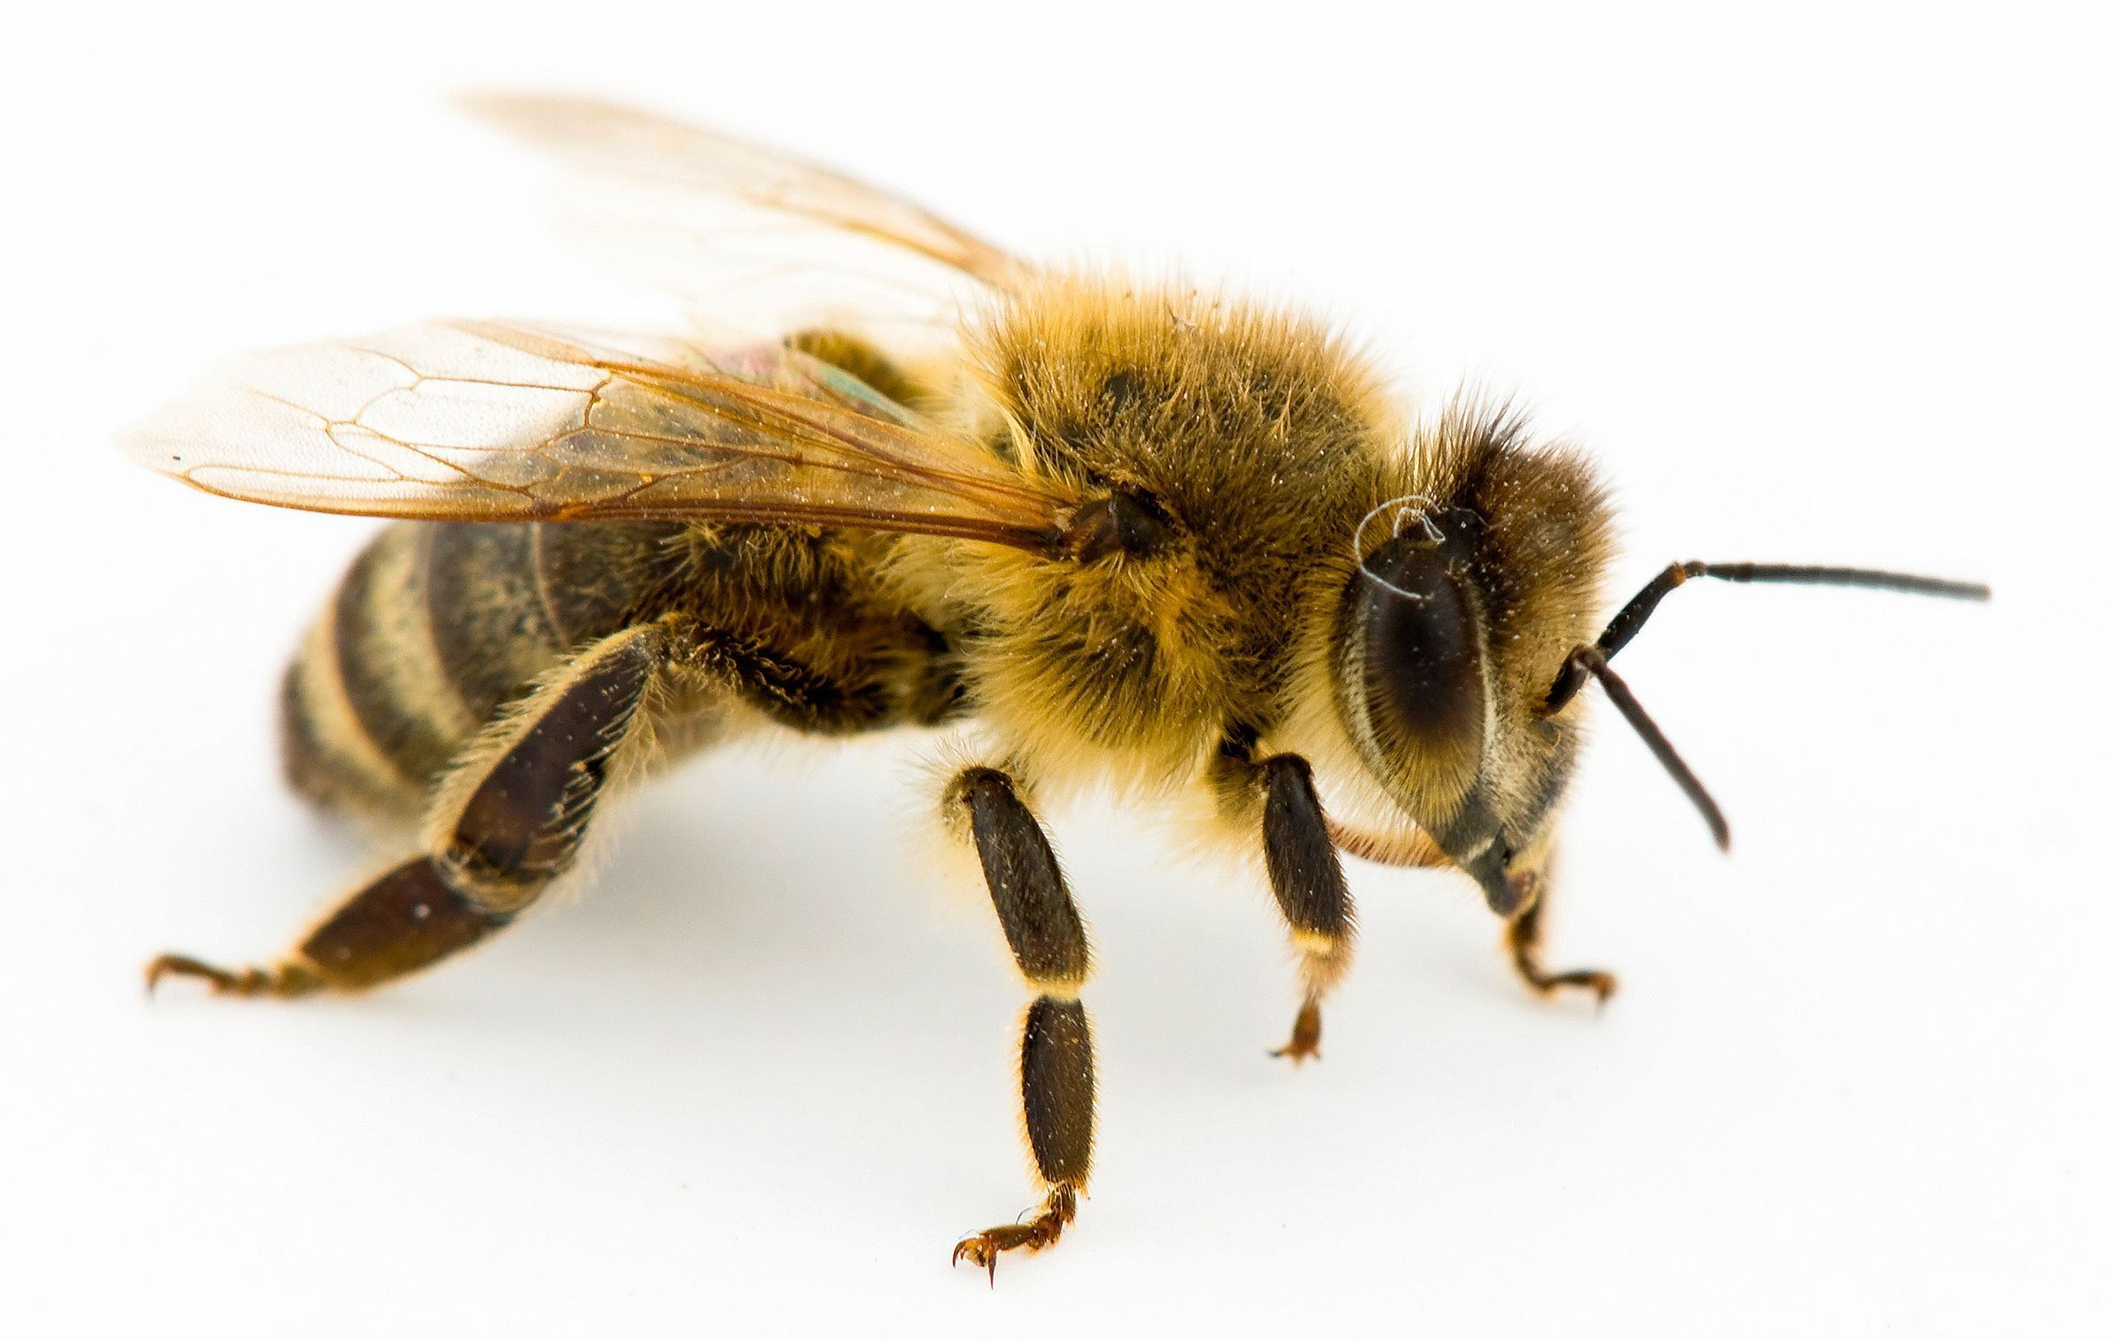
Haplodiploid arthropods
Occurs in many insect species
Offspring can develop without egg fertilization (parthenogenetically)
sexual
asexual
+

Slide 17



Manual dataset: flowchart
Host range
Body length
Pairs
Distribution

Slide 18
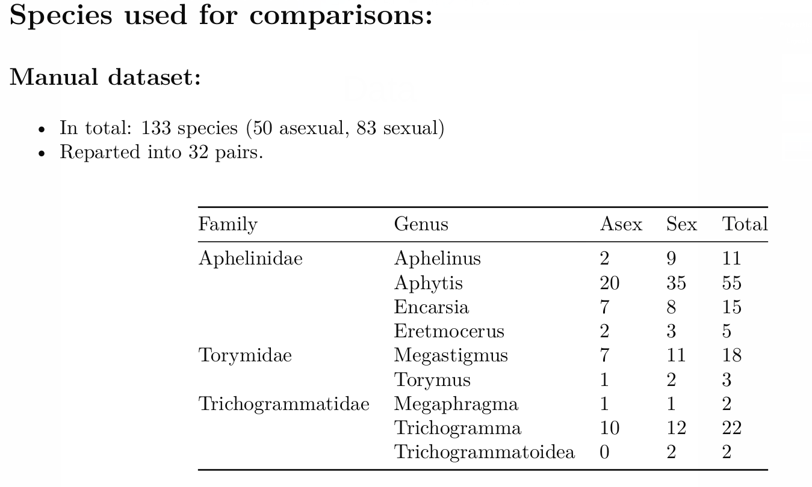
Manual dataset: Data

Slide 19



Automated dataset: flowchart
Only genera with at least one known parthenogen were used.
Nominatim:
Extracting coordinates
Stored for analysis
NHM Database
Host range
Distribution
Distribution
Host range

Slide 20
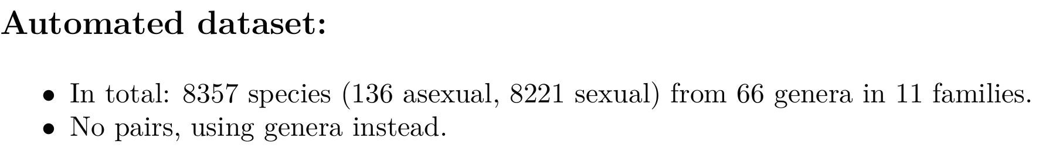
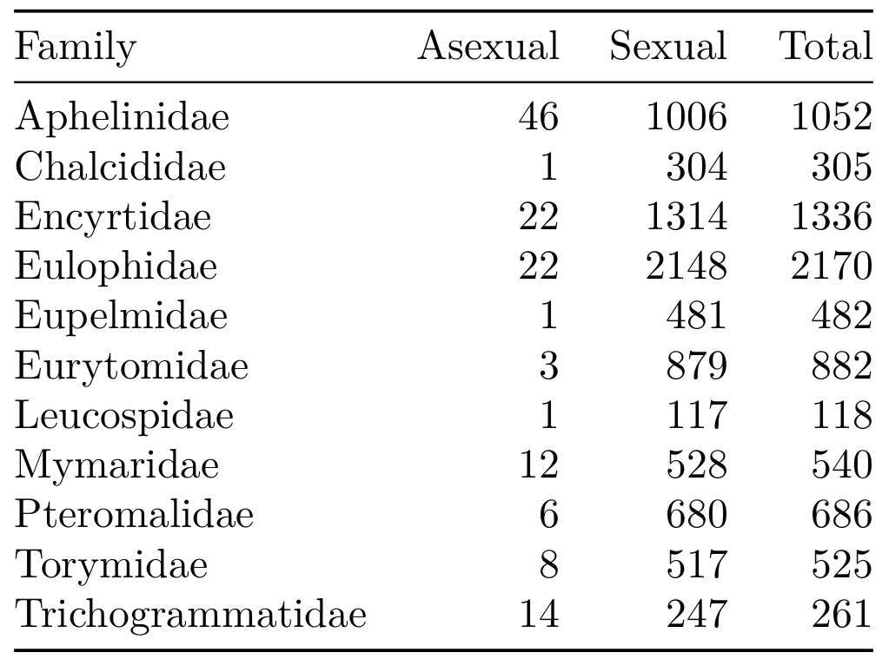
Automated dataset: Data

Slide 21
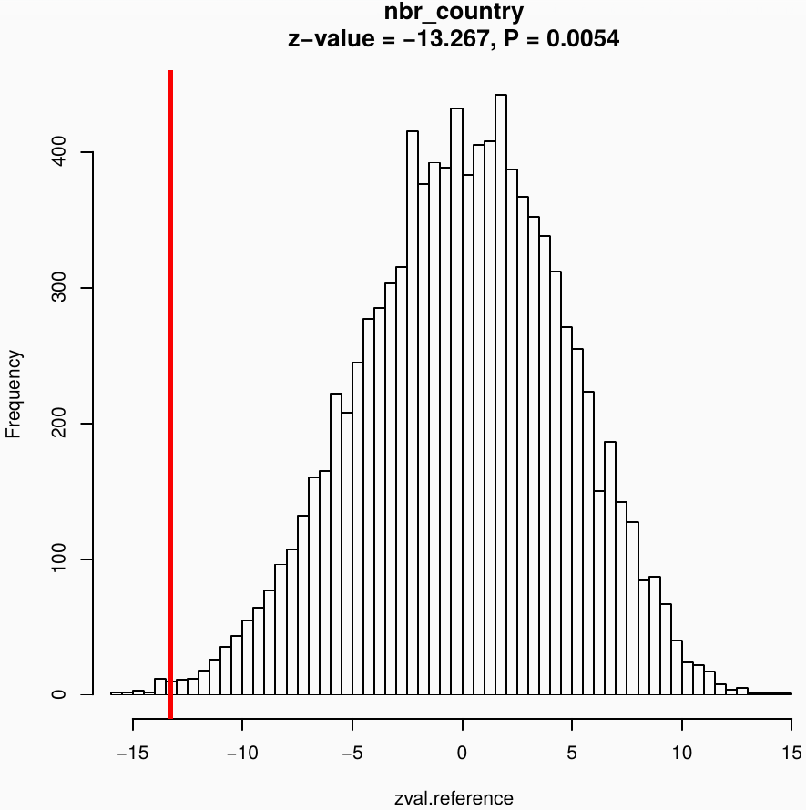
GLMM with permutation approach
asex
sex
model
Observed
statistic
observed
Genus
Random permutations
[...]
10,000 simulations
Reference
distribution

Slide 22
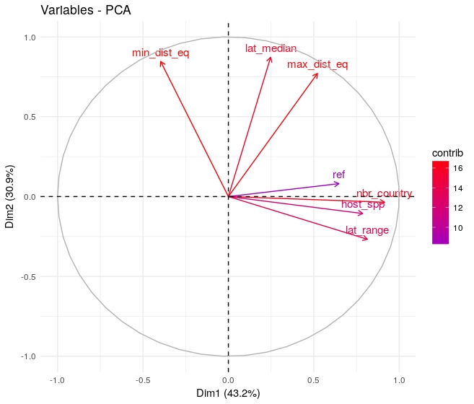
Automated dataset: Publication bias
Species with unknown reproductive mode considered sexual
Some variables strongly correlate with number of publications (ref)

Slide 23
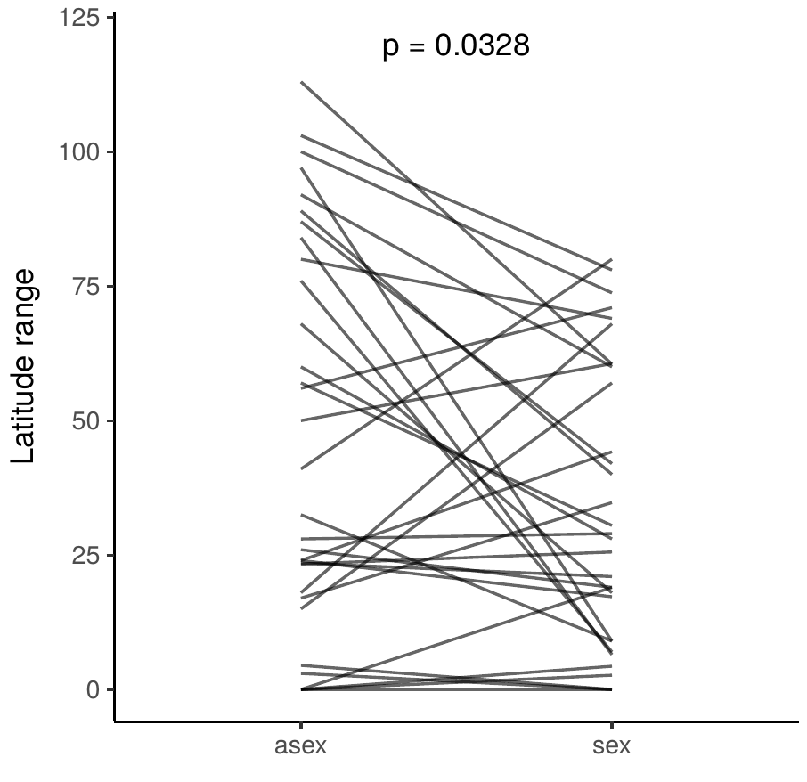
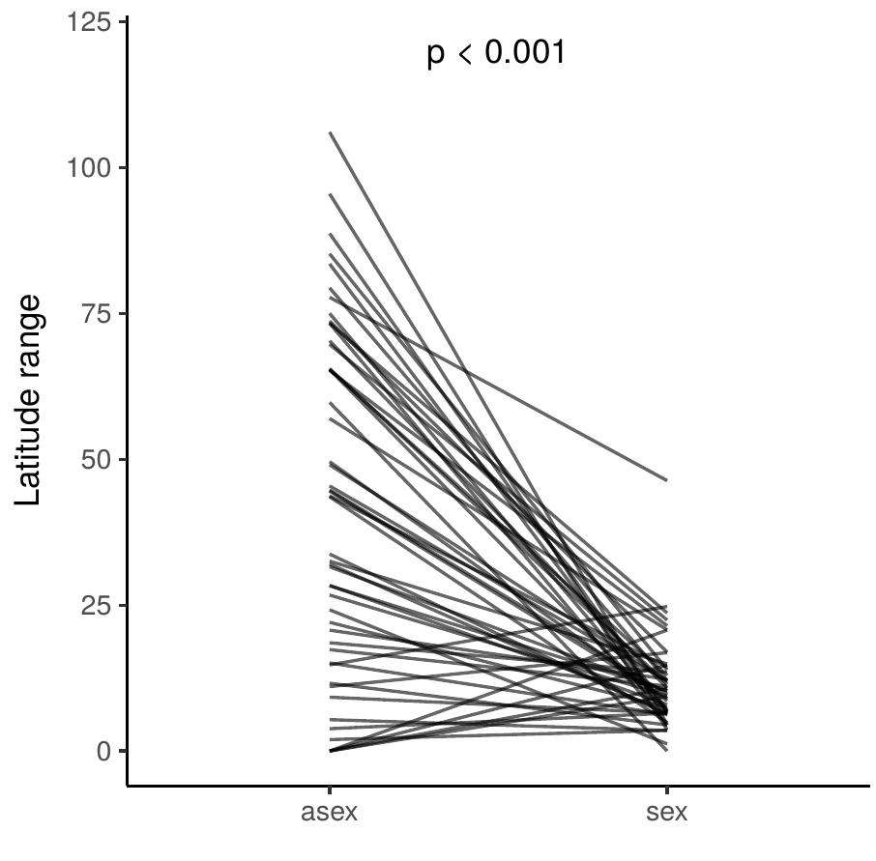
Results: Latitude range
Manual dataset:
Values per pair
Automated dataset
Values per genus

Slide 24
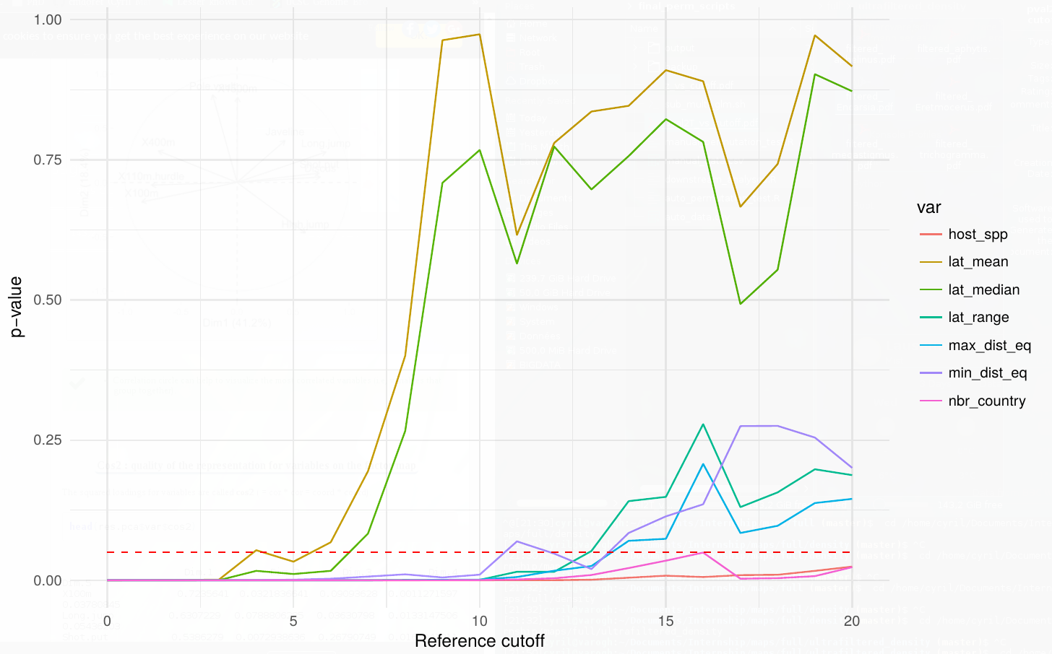
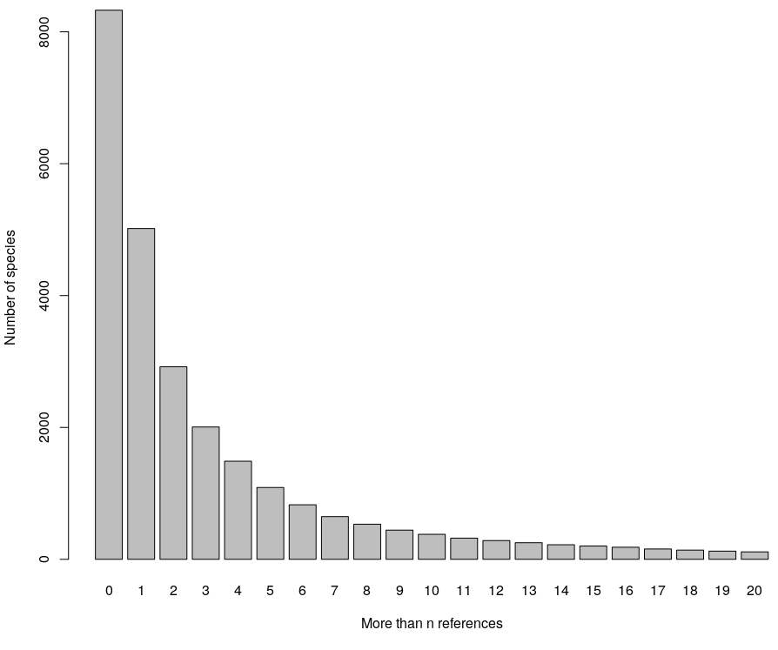
Automated dataset: Publication bias
Removing species with low number of publications
Trade off: bias vs power

Slide 25
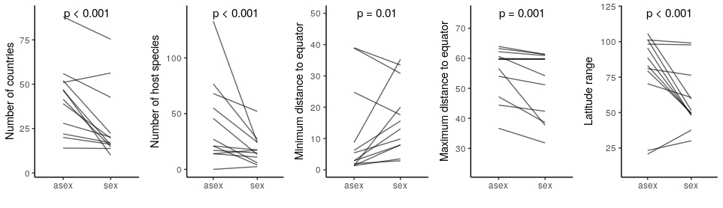
Automated dataset: Publication bias
Poorly studied species: unknown reproductive mode
considered sexual
Sexual species will have fewer known hosts and countries
Results are consistent when including only well studied species (>10 publications)
asex
sex
asex
sex
asex
sex
asex
sex
asex
sex

